Slide 1
A Seminar on YOLO WITH INTEGRATED MULTI-SCALE DOMAIN ADAPTATION
Team Details
Team No-18
1. G. Yashwanth (21Eg505827)
2. G. Sampath (21Eg505829)
3. S. Teja Reddy (21EG505859)
Project Supervisor
Mrs. B. Ujwala
Assistant Professor

Slide 2
Introduction
Improving YOLO's abilities with multiscale techniques helps spot objects better, no matter their size. This is great for things like keeping an eye on areas with cameras or helping self-driving cars know what's around them. Integrated Multi-Scale Domain Adaptive YOLO deals with tricky situations like different lights or backgrounds, which is really important for systems that need to recognize objects reliably. Its adaptability is key for places where traditional detection systems struggle. This kind of adaptability is super useful for smart cities, factories, and keeping an eye on things. It helps make self-driving cars safer and better at making decisions too.

Slide 3
Problem Statement
Detecting objects accurately with YOLO can be difficult, especially when objects vary in size, which is common in surveillance and self-driving cars. Traditional systems also face challenges in places like smart cities and factories where conditions change a lot, making it hard for them to adapt. The current ways of doing things aren't great at working across different situations, which can be a problem in fast-changing environments like factories and surveillance. Overall, the methods we have now aren't very good for robust applications like making cities smarter, automating factories, and surveillance in real life.

Slide 4
Proposed Method
The new system, called Multi-Scale Domain Adaptive YOLO (MS-DAYOLO), is really important. It's designed to tackle the problem of things looking different in pictures or videos compared to real life. We tested it carefully against the standard YOLOv4 to show how well it works. It's great because it can handle lots of different situations and make accurate guesses about what objects are in images or videos. This helps make object detection better overall.
ADVANTAGES
MS-DAYOLO is great at adapting to different environments, making it really good at spotting objects in all kinds of real-world situations.
It works well even when conditions change a lot, so you can rely on it to accurately detect objects no matter what's going on around it.
When compared to YOLOv4, MS-DAYOLO stands out for its improvements, showing that it's really good at finding objects with precision.
It's made specifically for real-life situations, like in self-driving cars or surveillance, where it's important to detect objects reliably for safety and efficiency.

Slide 5
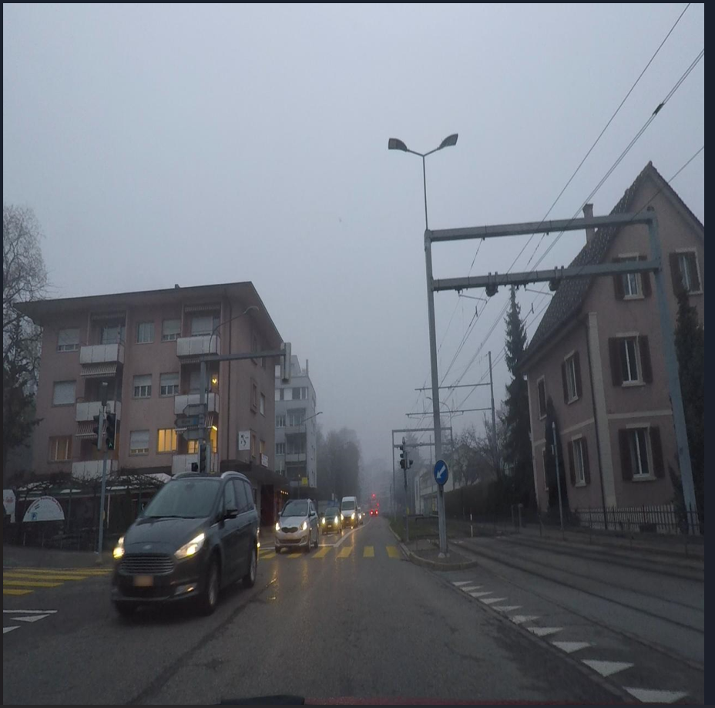
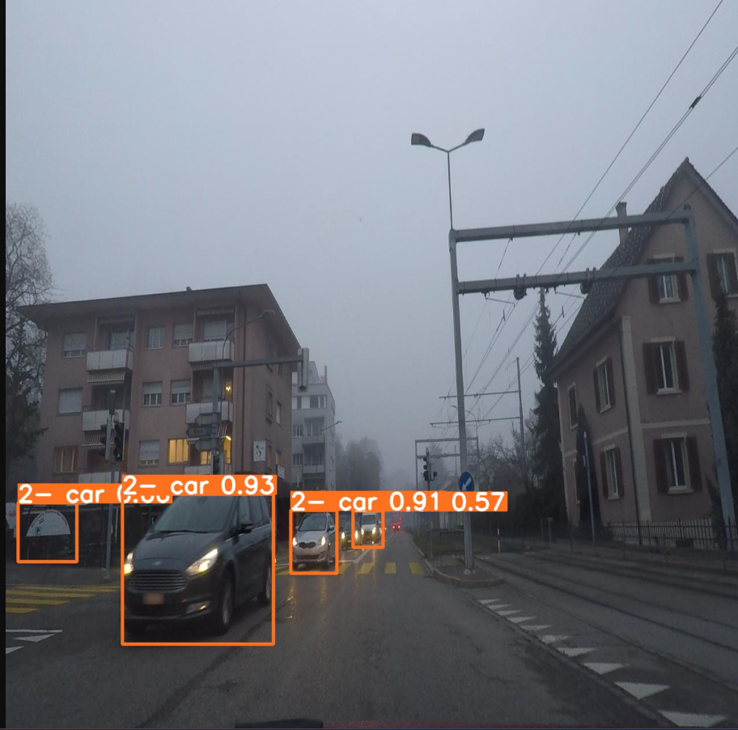
Proposed method Illustration
Before
After

Slide 6
Proposed Method
The project combines YOLOv4 and MS-DAYOLO to tackle the challenges of object detection in different environments. MS-DAYOLO strengthens YOLOv4 by helping it adapt to various situations through multiscale domain adaptation. This makes YOLOv4 more effective in different scenarios. The project focuses on areas like autonomous vehicles and surveillance to make YOLO-based models more flexible. By improving their ability to adapt, the project aims to provide reliable and versatile solutions for object detection, ready to handle a wide range of real-world problems.

Slide 7
Experiment Environment
Tools:
Anaconda
Sqlite
Jupyter Notebook
Language:
Python
Dataset:
The dataset is collected from Kaggle. And also we can create dataset from the https://www.cityscapes-dataset.com/

Slide 8
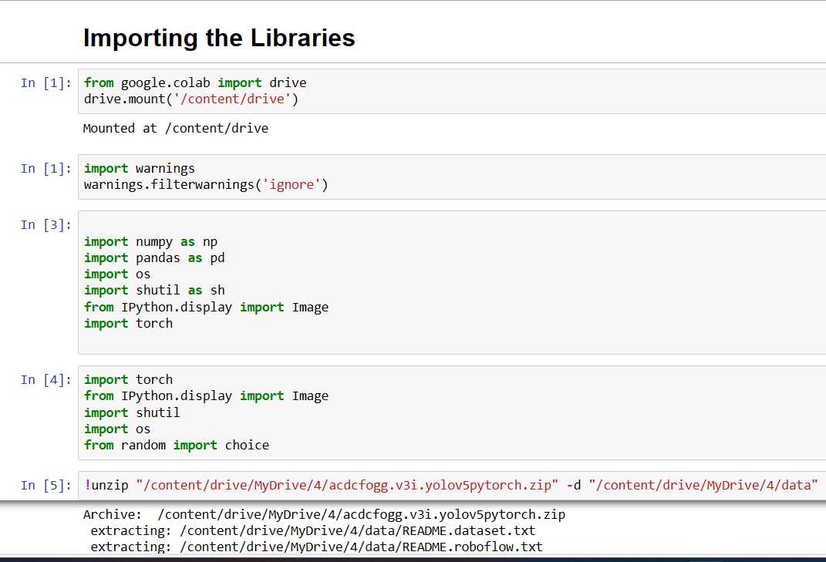
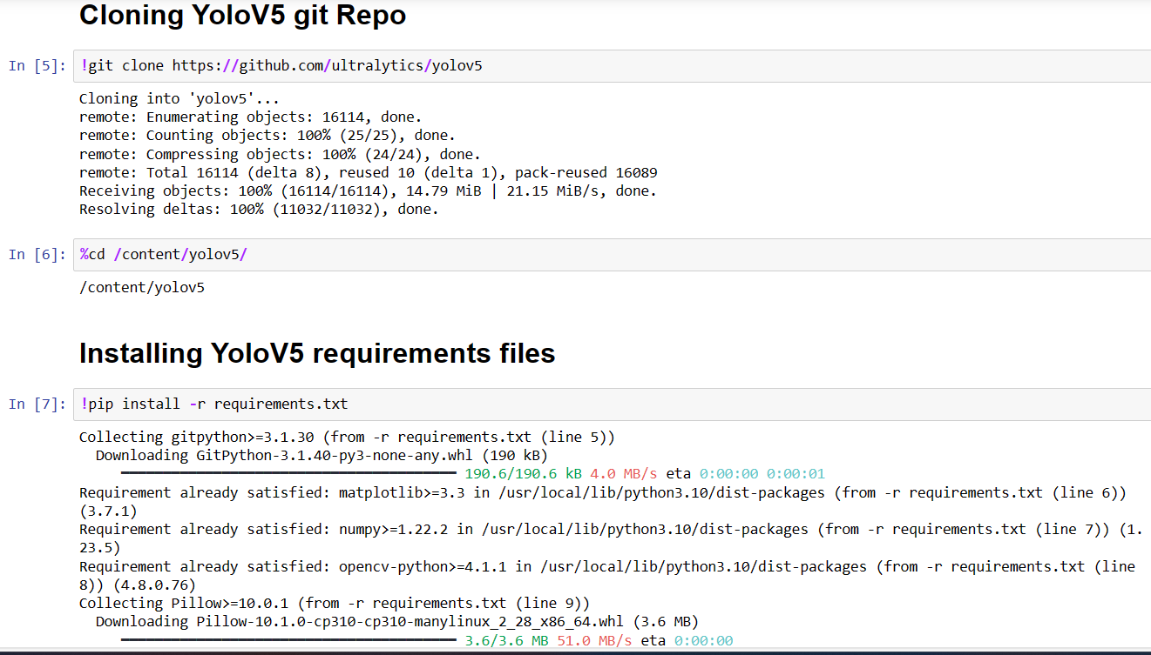
Experiment Screen shorts

Slide 9
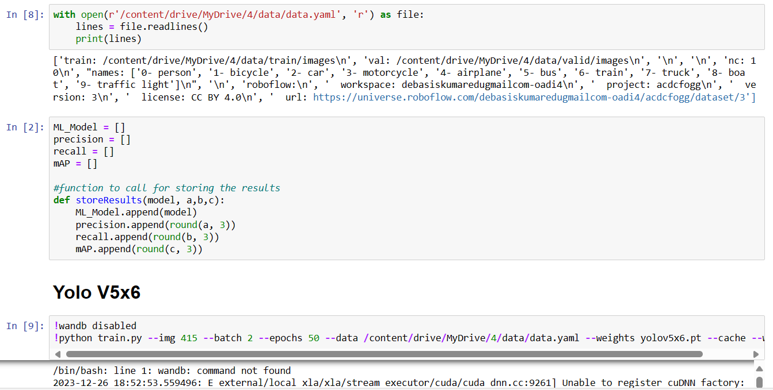
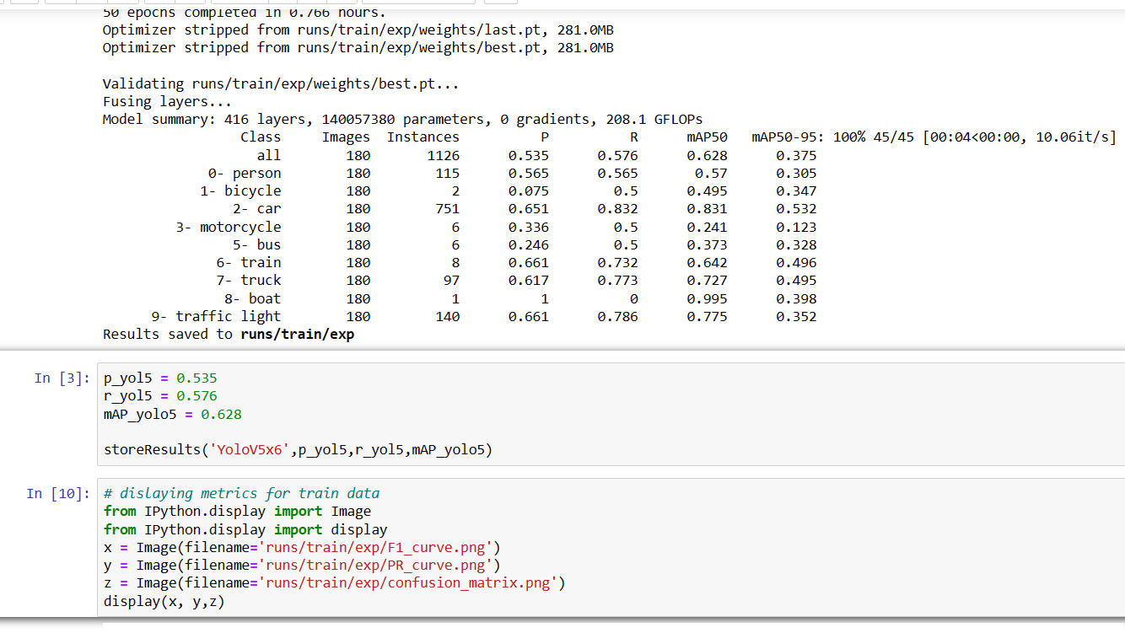
Experiment Screen shorts

Slide 10
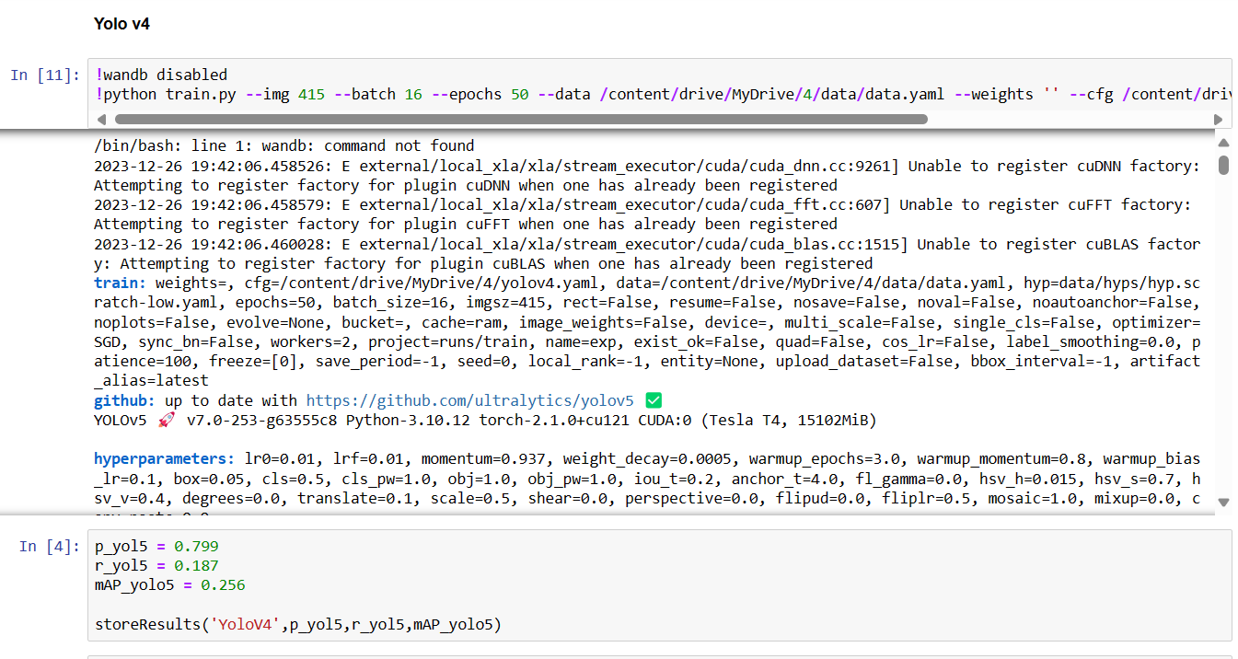
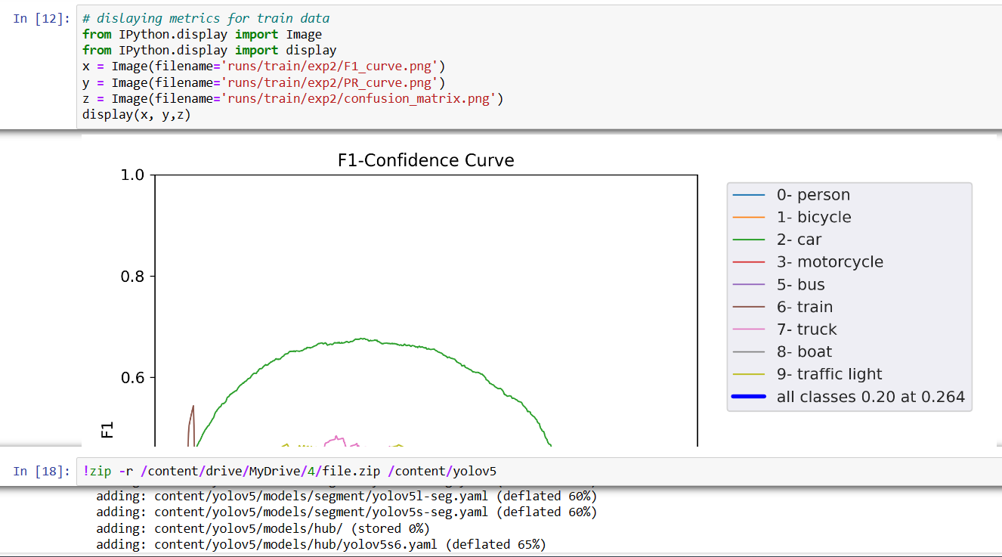
Experiment Screen shorts

Slide 11
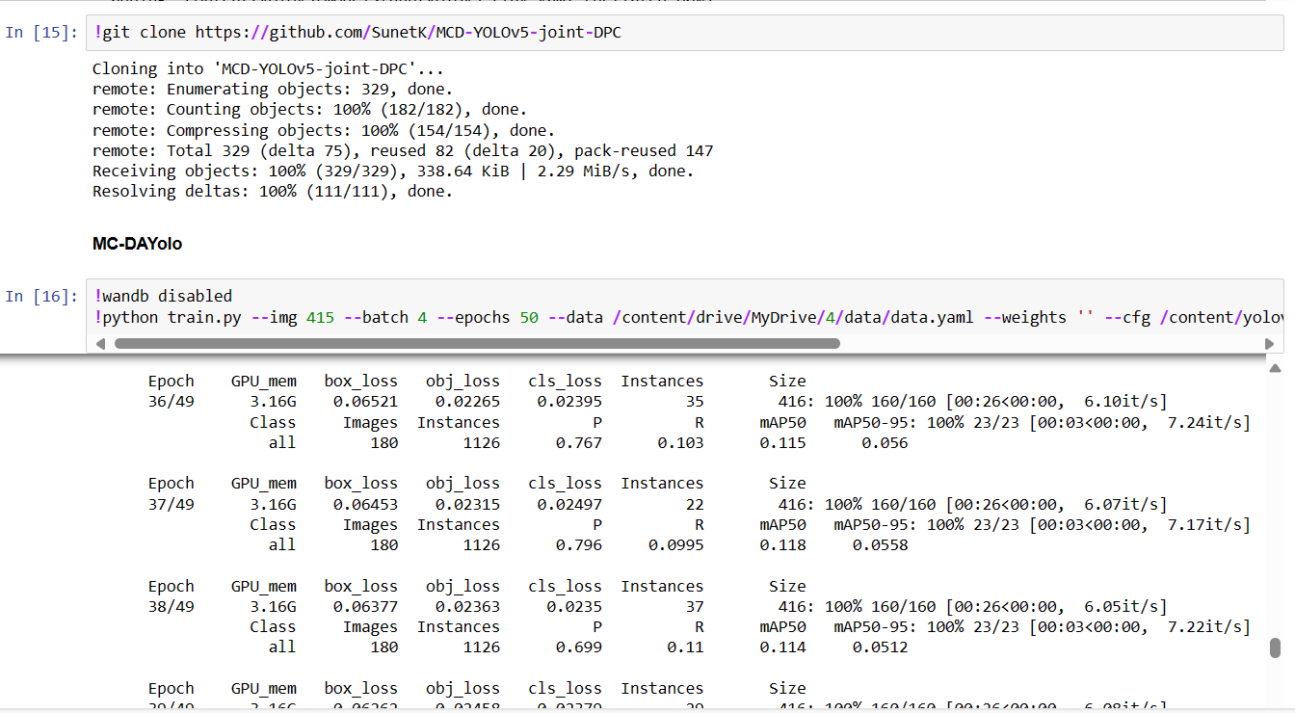
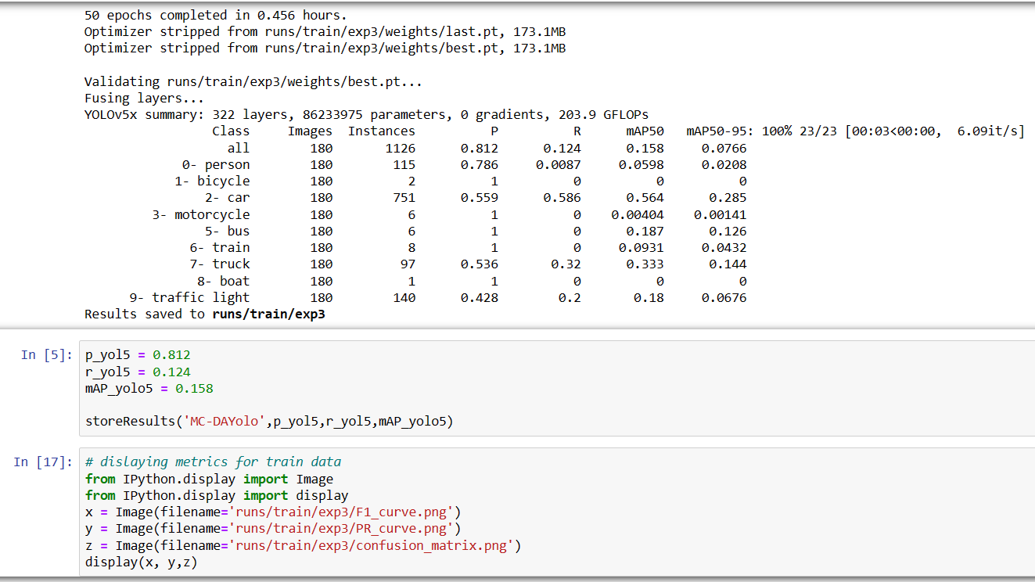
Experiment Screen shorts

Slide 12
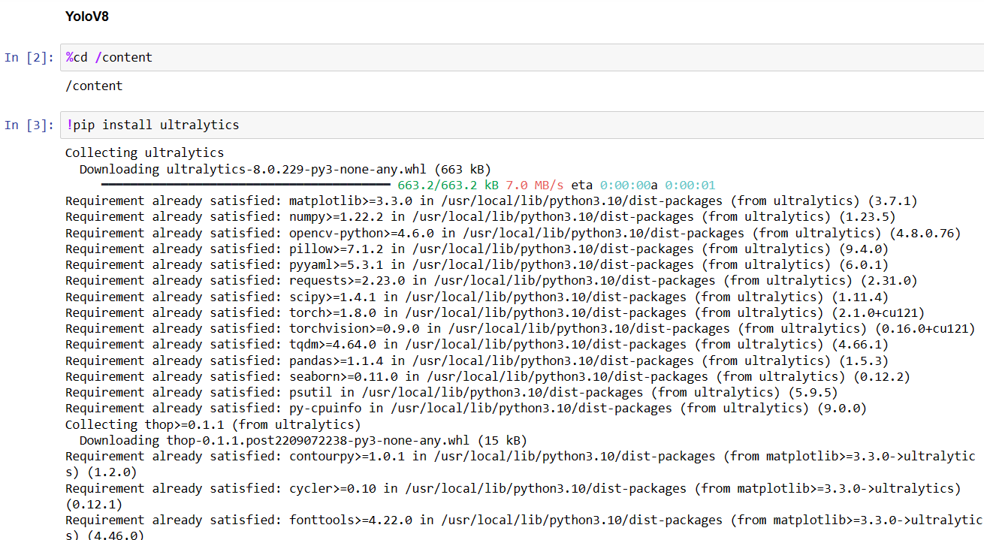
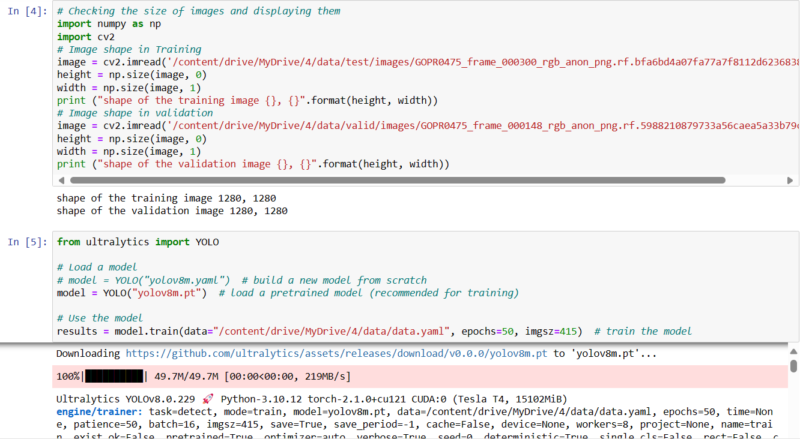
Experiment Screen shorts

Slide 13
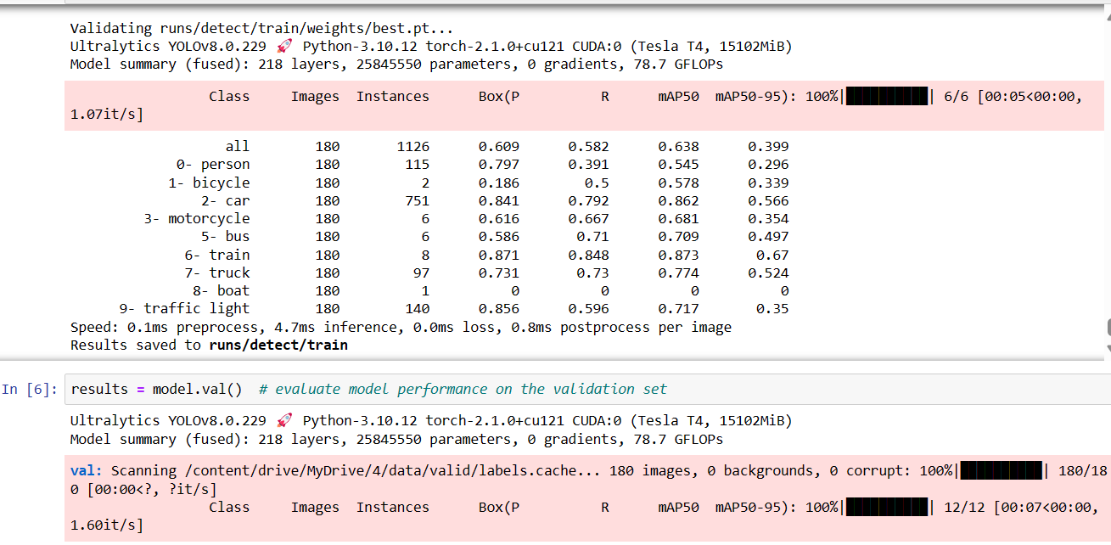
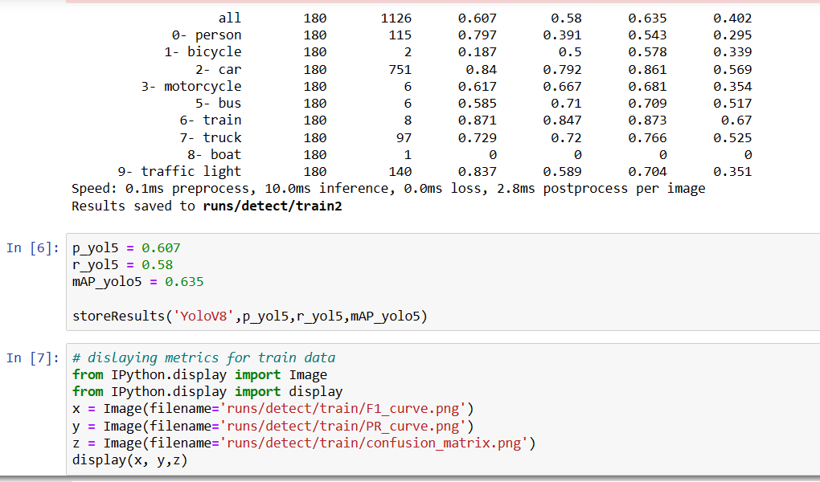
Experiment Screen shorts

Slide 14
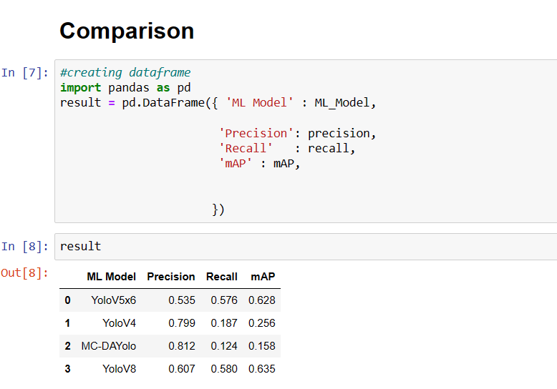
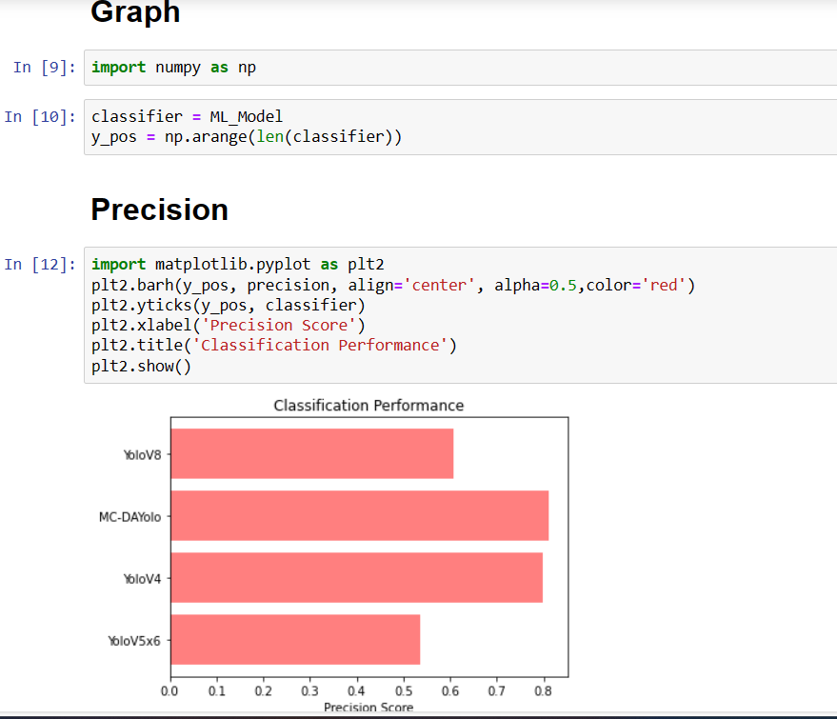
Experiment Screen shorts

Slide 15
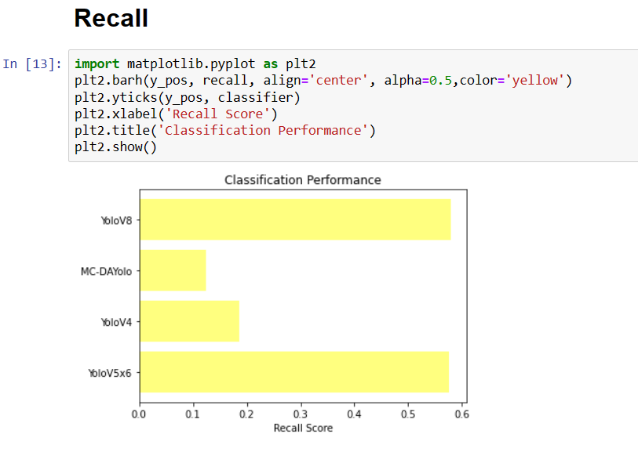
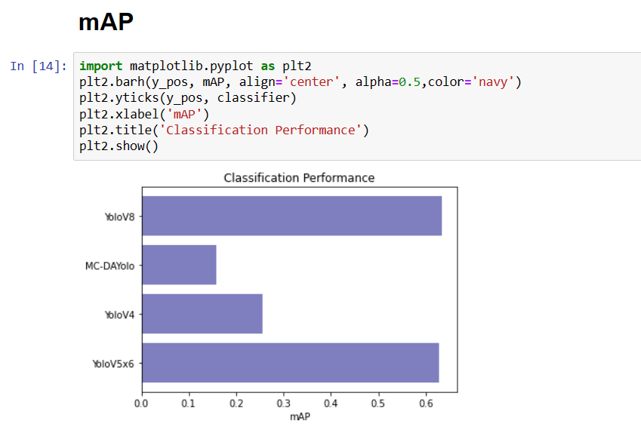
Experiment Screen shorts

Slide 16
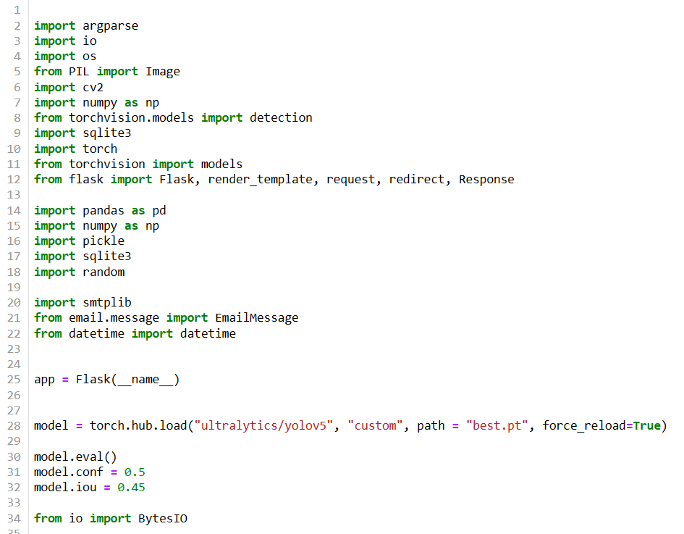
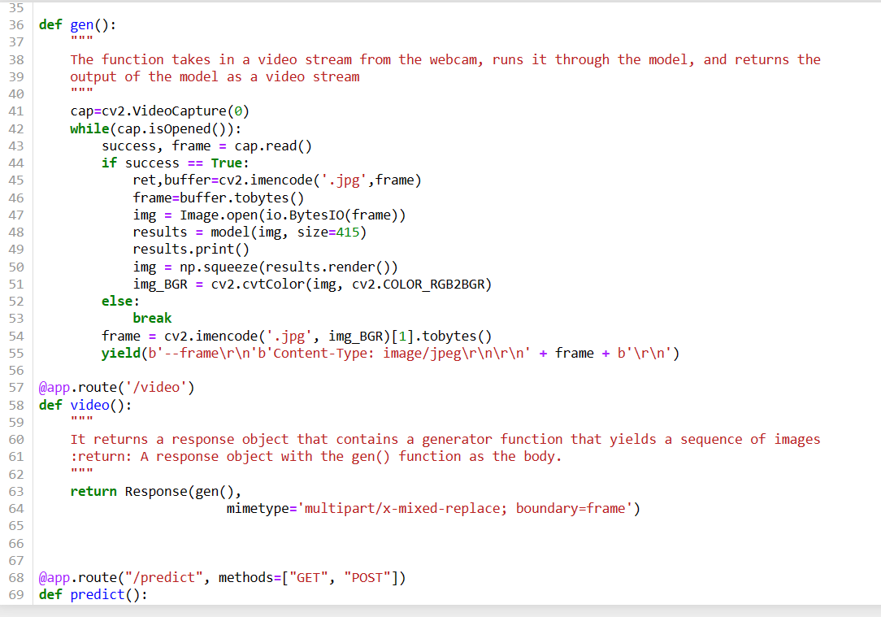
Experiment Screen shorts

Slide 17
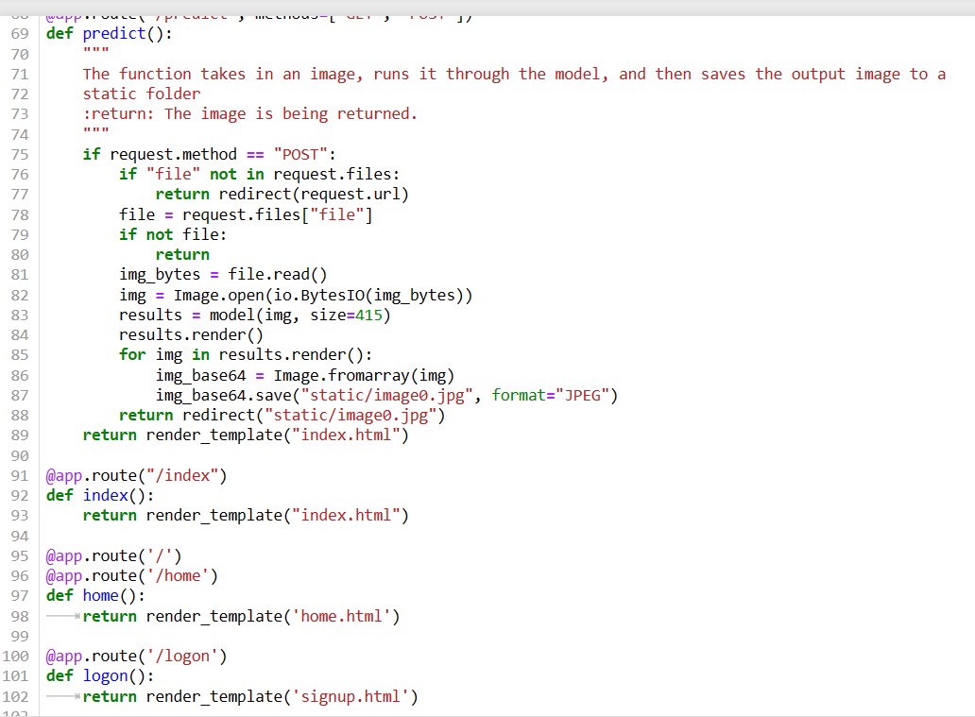
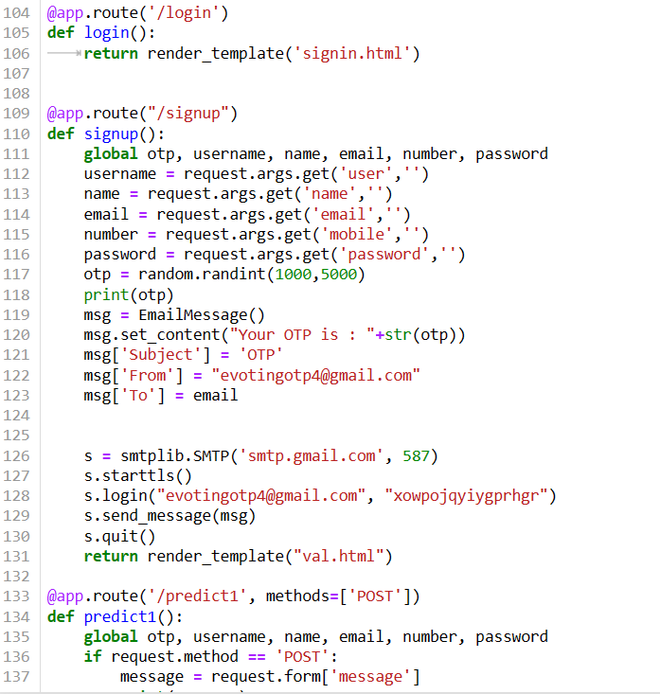
Experiment Screen shorts

Slide 18
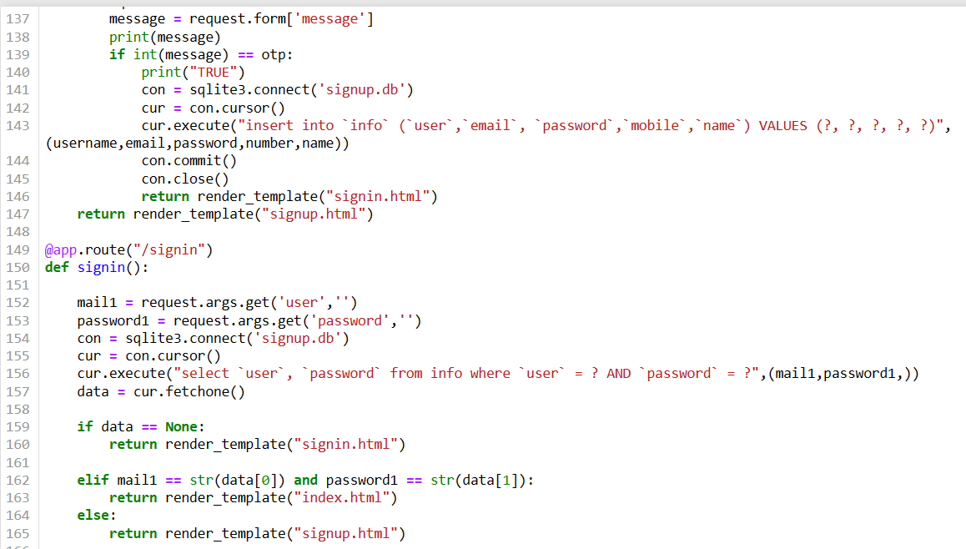
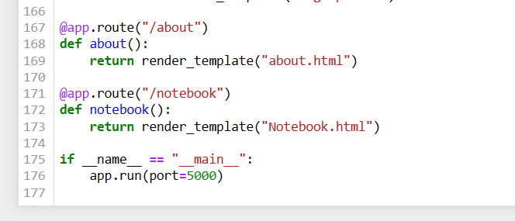
Experiment Screen shorts

Slide 19
Experiment Results
Objects will be detected with bounded boxes and probability in image when we upload an image

Slide 20
Finding
1. Integration of multiscale domain adaptation techniques into YOLOv4, known as MS-DAYOLO, significantly enhances robustness and generalization capabilities in object detection tasks.
2. MS-DAYOLO effectively mitigates domain shift challenges, resulting in improved detection accuracy and adaptability across diverse scenarios, validated through experimental evaluations in domains like autonomous vehicles and surveillance.

Slide 21
Justification
Parameters improved by MS-DAYOLO include detection accuracy, robustness to domain shift, and generalization across diverse scenarios, enhancing adaptability of YOLOv4 for object detection.
MS-DAYOLO calculates improved parameters by incorporating Multi-Scale domain adaptation techniques into YOLOv4, adjusting feature representations and classifier boundaries based on domain-specific characteristics.
The parameter values are improved because Multi-Scale domain adaptation effectively aligns feature distributions across domains, minimizing domain shift effects and enabling YOLOv4 to learn more robust and generalizable representations for object detection tasks.

Slide 22
THANK YOU

